Slide 1






SSB – MuleSoft CloudHub Overview
Updated: April 05, 2021

Slide 2
Objectives
High level overview of CloudHub Architecture

Slide 3
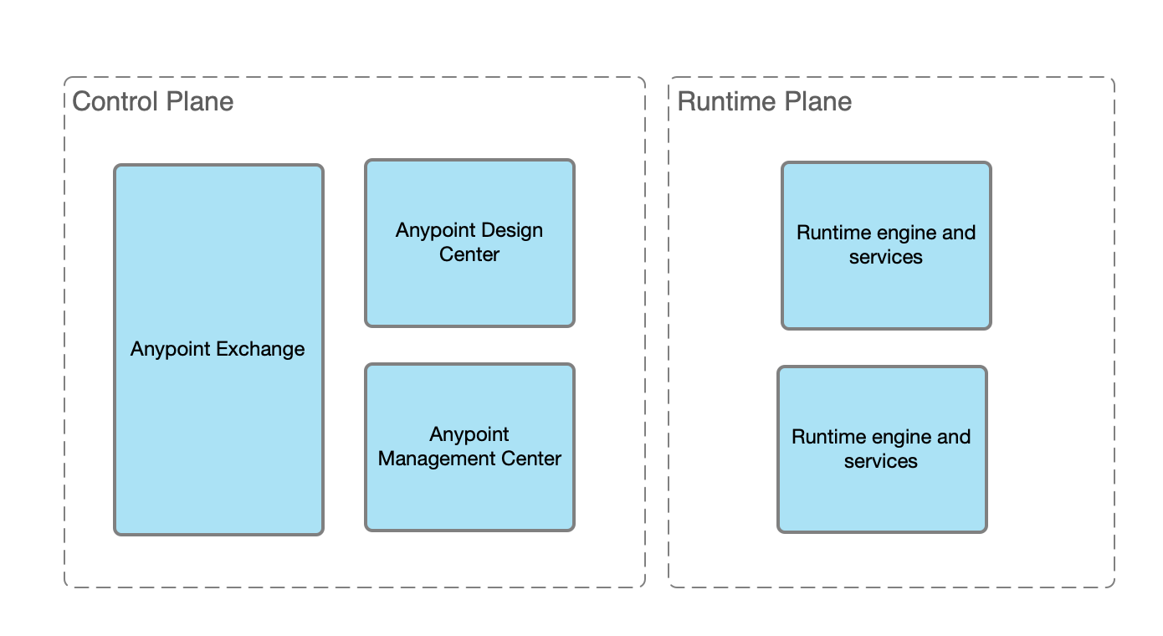
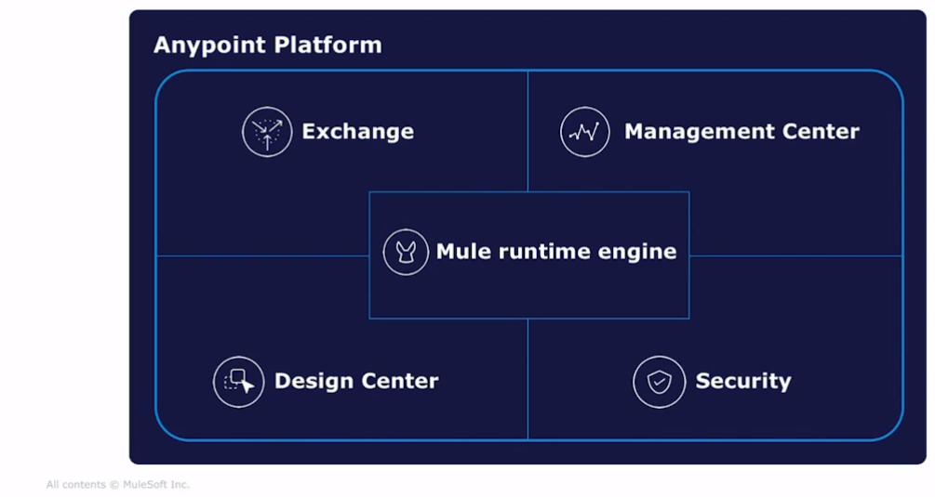
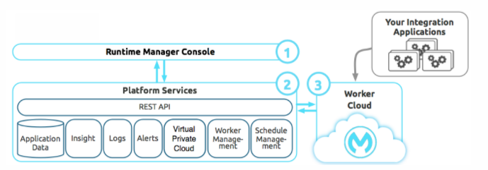
Logical View

Slide 4
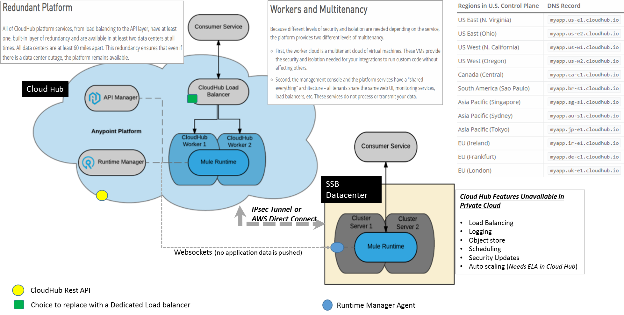
Deployment Component View - CloudHub & Hybrid

Slide 5
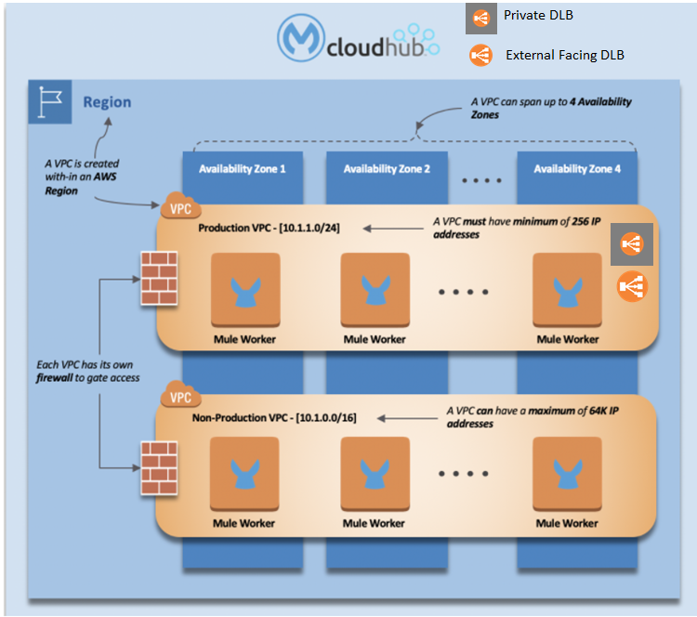
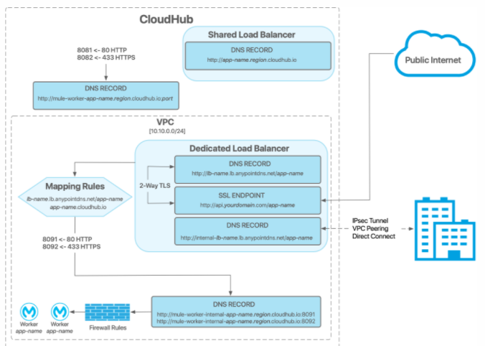
Deployment View – VPCs
*** Unlike AWS VPC, Cloudhub VPC only supports a single subnet.
*** Use DLBs to separate External versus Internal traffic instead of subnets

Slide 6
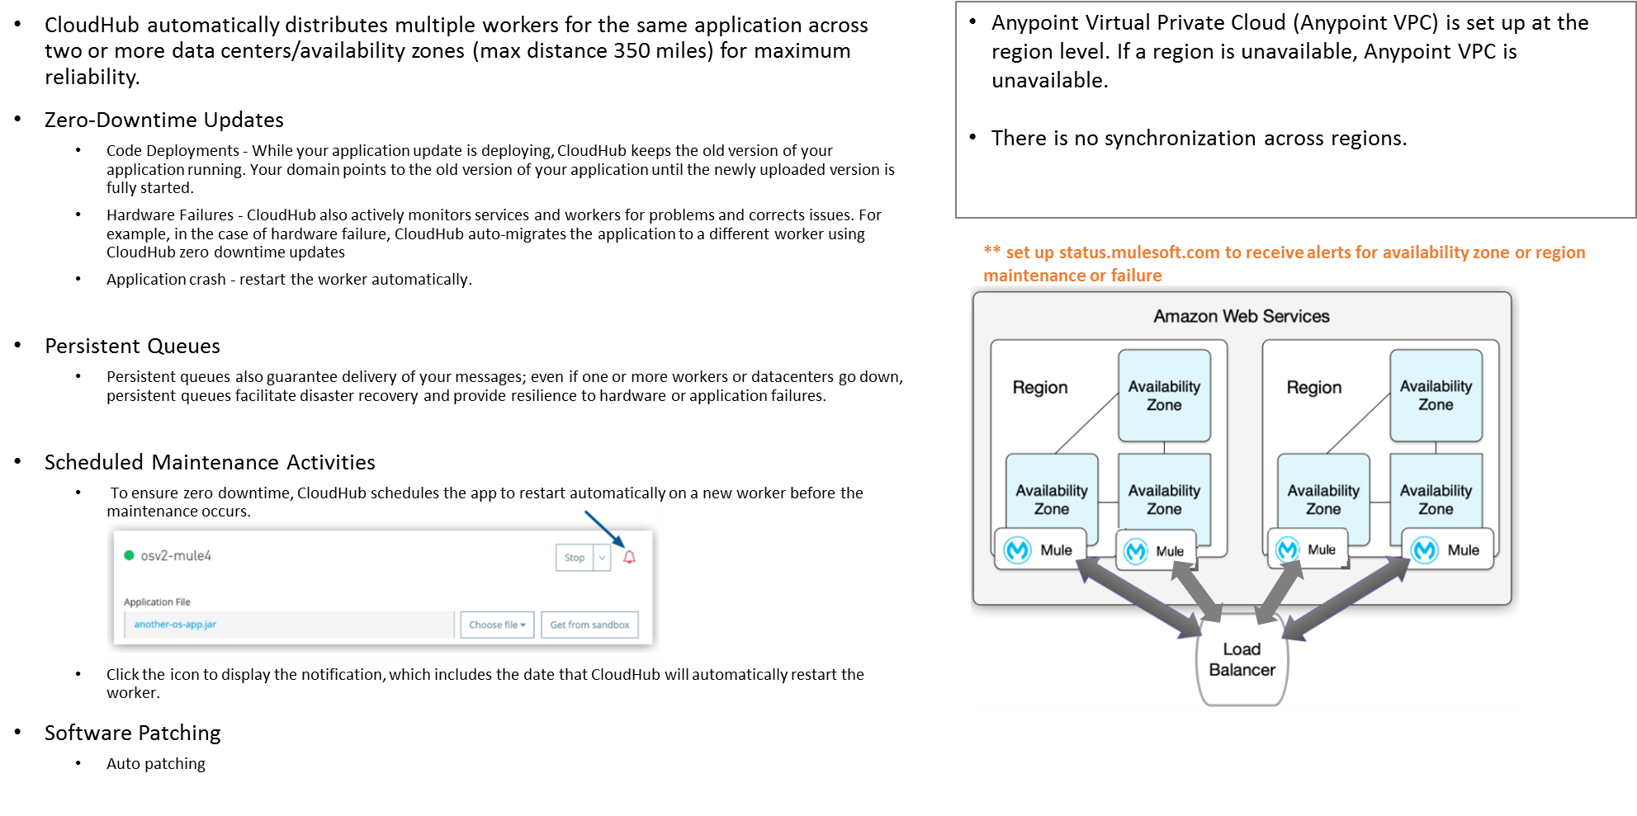
High Availability

Slide 7
Other CloudHub Features Review
Running Multiple Versions
Safely Hide Application Properties - https://docs.mulesoft.com/runtime-manager/secure-application-properties
Monitoring
With Runtime Manager, you can set up both alerts based on alert conditions on deployed apps and standard notifications to inform you when events occur in your applications via Email

Slide 8

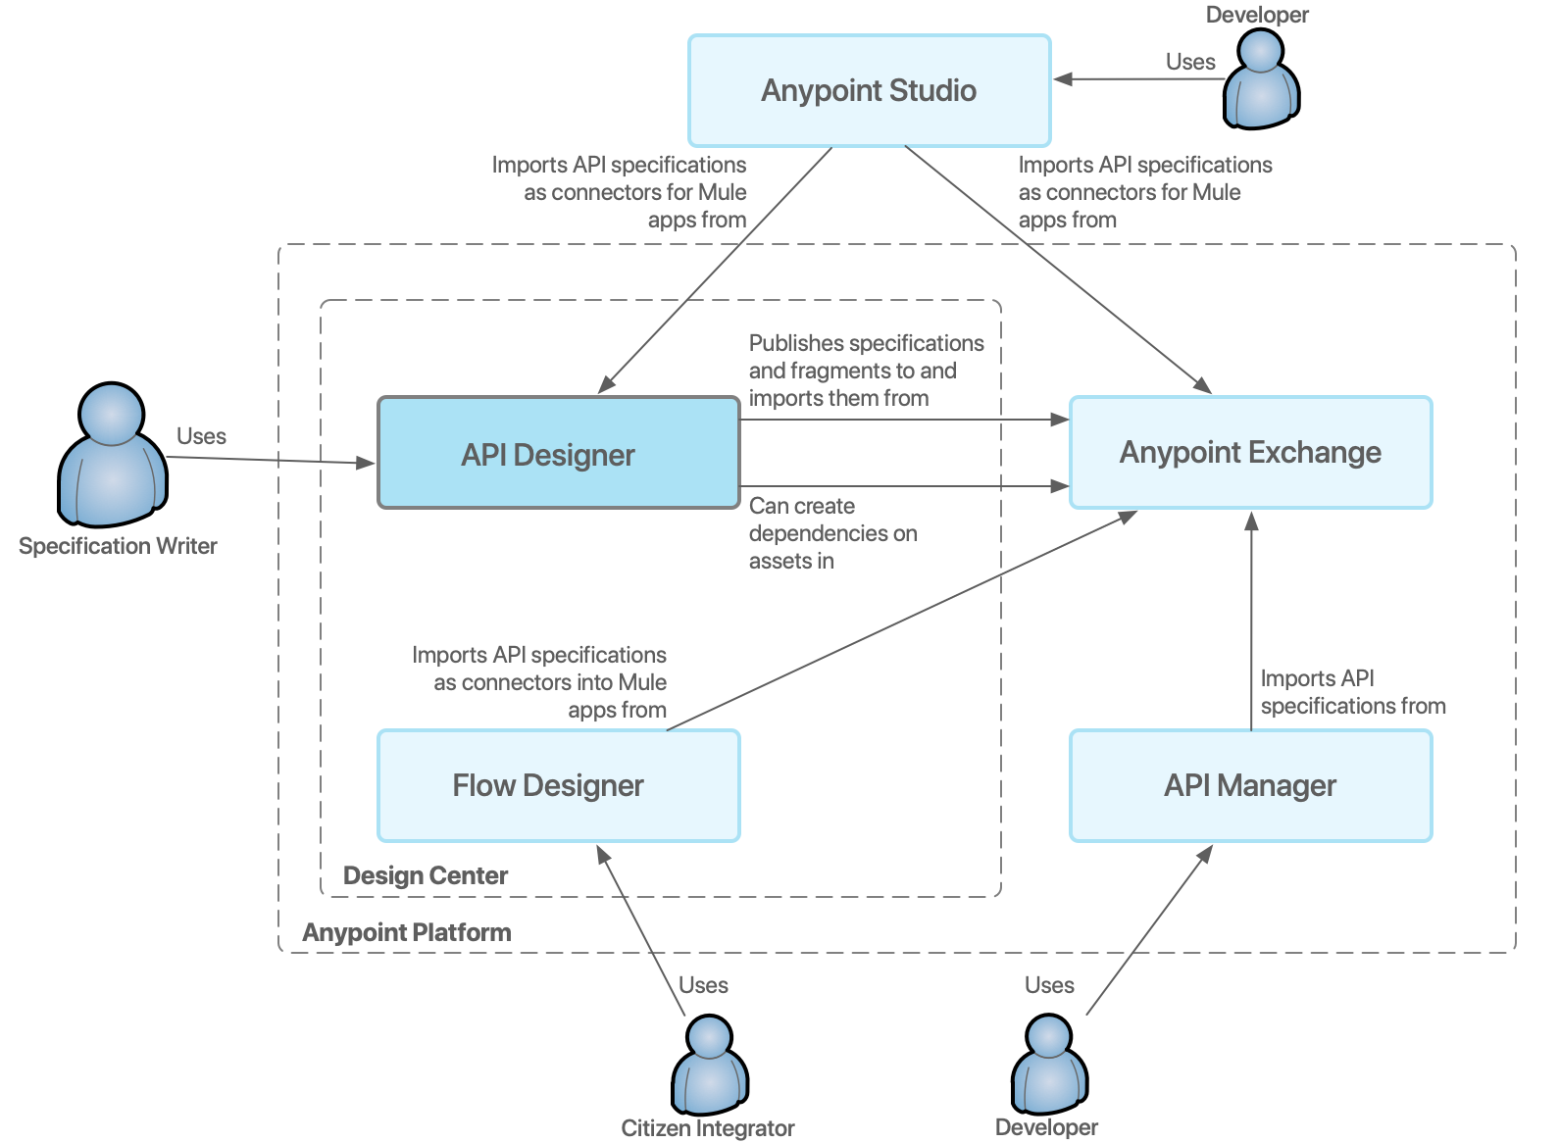
Architecture (Development View)
Code
Code versioning
Deploy
Package
Control
Plane
Runtime
Plane
CloudHub Anypoint Platform
SSB Data Center

Slide 9

Thank you!
PwC | Sandy Spring Bank
Confidential information for the sole benefit and use of PwC’s client

